Slide 1

Object Oriented Programming (OOP) Course Code: CSE2005/SWE2005
MODULE – 1
(Object-Oriented Programming – Fundamentals)
By:
Dr. Nagendra Panini Challa
Assistant Professor, Senior Grade 2
SCOPE, VIT-AP University, India

Slide 2
Agenda
Basics of OOP
Features of OOP
Introduction to Java
Objects and Classes in Java
Defining Classes
Methods
Access Specifiers
Static Members
Constructors
this Keyword
Encapsulation
Inheritance: Inheritance Hierarchies
Super and Subclasses
access control
super keyword
final keyword
final classes and methods

Slide 3
Basics of OOP
As the name suggests, Object-Oriented Programming or OOPs refers to languages that uses objects in programming.
Object-oriented programming combines a group of data attributes with functions or methods into a unit called an "object."
The main aim of OOP is to bind together the data and the functions that operate on them so that no other part of the code can access this data except that function.

Slide 4
A simple example would be a class representing a person.
The person class would contain attributes to represent information such as the person’s age, name, height, etc.
The class definition might also contain functions such as "sayMyName" which would simply print that person’s name to the screen.
Each person object would contain different data attributes since each person is unique.
A family could be constructed by instantiating person objects from the class for each member of the family.

Slide 5
This OO programming style is pervasive in popular programming languages such as Java, C++, Python, JavaScript and C# among others.
By defining sets of classes that represent and encapsulate objects in a program, the classes can be organized into modules, improving the structure and organization of software programs.
Thus, developers often use OOP as a tool when they need to create complex programs since they are easier to reason in terms of classes and their relationships.

Slide 6
Programming Paradigms
Procedural oriented Programming
program is a list of instructions to the computer
Object Oriented Programming
program is composed of a collection objects that communicate with each other

Slide 7
Procedural Oriented Programming
Program is divided into small parts called as functions
It follows top down approach
No access specifiers in this paradigm
Adding new data and function is not easy
It is not having proper data hiding mechanism so that it is less secure
In this model, function is more important than data
Ex: C, FORTRAN, PASCAL etc...

Slide 8
Object Oriented Programming
In this model, Program is divided into small parts called Objects
It follows bottom up approach
It have access specifiers like Public, Private and Protected
Adding new data and functions is easy
It is more secure
In this model, data is more important than function
Ex: C++, Java, Python etc...

Slide 9
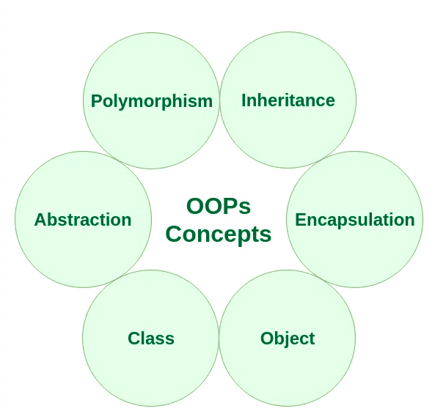
Features of OOP

Slide 10
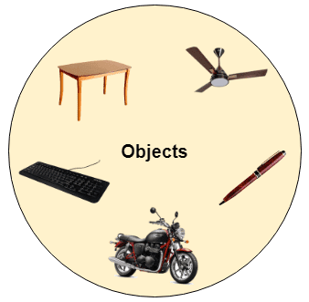
Object
Any entity that has state and behavior is known
as an object. For example, a chair, pen, table,
keyboard, bike, etc.
A dog is an object because it has states
like color, name as well as behaviors
like barking, eating.

Slide 11
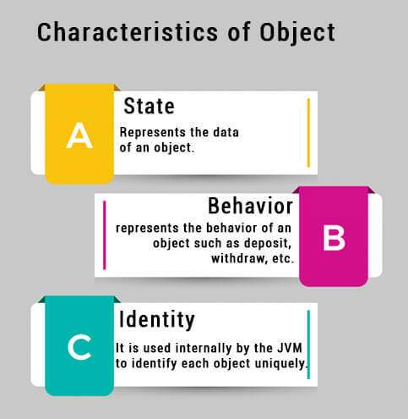
A Java object is a member (also called an instance) of a Java class.
Each object has an identity, a behaviour and a state.
The state of an object is stored in fields (variables), while methods (functions) display the object’s behaviour.
Objects are created at runtime from templates, which are also known as classes.
Java objects are very similar to the objects we can observe in the real world.
Ex: A cat, a lighter, a pen, or a car are all objects.
For Example, Pen is an object.
Its name is Reynolds; color is white, known as its state.
It is used to write, so writing is its behavior.
P can be identifier

Slide 12
Class
Student (Class) {
Defined by an instance (Object)
Name, Roll number, Branch (Properties of the object)
Read(), Write() and Play() (Tasks Performed)
}
Collection of objects is called class.
It is a logical entity.
An object is an instance of a class.
We can create many instances of a class.
A Java class uses variables to define data fields and methods to define actions.
A class can also be defined as a blueprint from which you can create an individual object.

Slide 13
Abstraction
It is a process of hiding implementation details and exposes only the functionality to the user.
In abstraction, we deal with ideas and not events.
This means the user will only know “what it does” rather than “how it does”.
Real-Life Example-
A driver will focus on the car functionality (Start or Stop, Accelerate or Break), he or she does not bother about how the Accelerate or brake mechanism works internally. And this is how the abstraction works.

Slide 14
Encapsulation
Encapsulation is the process of wrapping code and data together into a single unit.
Real-Life Example: A capsule which is mixed of several medicines. The medicines are hidden data to the end user.

Slide 15
Polymorphism
Polymorphism is the ability to perform many things in many ways.
The word Polymorphism is from two different Greek words- poly and morphs.
“Poly” means many, and “Morphs” means forms. So polymorphism means many forms.
Real-life Example:
A delivery person delivers items to the user. If it’s a postman he will deliver the letters. If it’s a food delivery boy he will deliver the foods to the user. Like this polymorphism implemented different ways for the delivery function.

Slide 16
Inheritance
Inheritance is the process of one class inheriting properties and methods from another class in Java.
Inheritance is used when we have a relationship between objects.
Inheritance in Java is implemented using extends keyword.
Real-life Example:
The planet Earth and Mars inherits the super class Solar System and Solar system inherits the Milky Way Galaxy. So Milky Way Galaxy is the top super class for Class Solar System, Earth and Mars.

Slide 17
What is Java
Java is a high level programming language and a platform.
Java is a high level, robust, object-oriented and secure programming language.
Any hardware or software environment in which a program runs, is known as a platform.
Since Java has a runtime environment (JRE), it is called a platform.

Slide 18
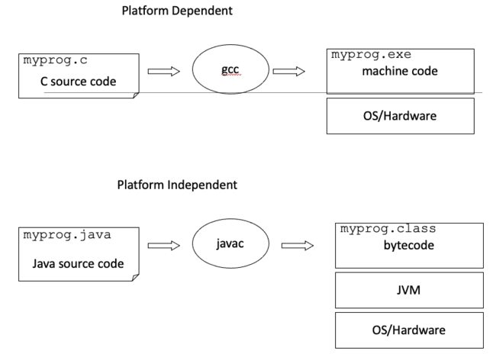

Slide 19
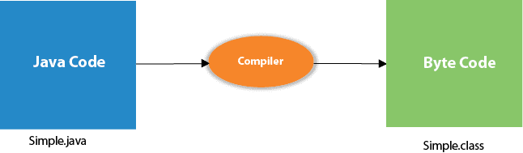
Compilation

Slide 20
JVM (Java Virtual Machine) is an abstract machine. Loads code, Verifies code, Executes code, Provides runtime environnent where bytecode can be executed.
The Java Runtime Environment (JRE) is a set of software tools which are used for developing Java applications.
The Java Development Kit (JDK) is a software development environment which is used to develop Java applications.

Slide 21
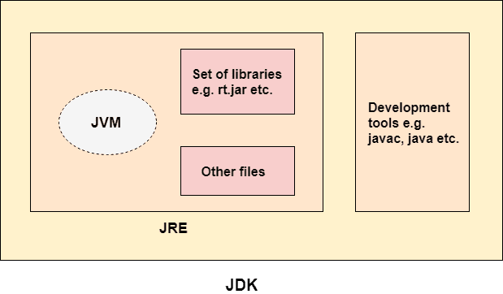
JVM?

Slide 22
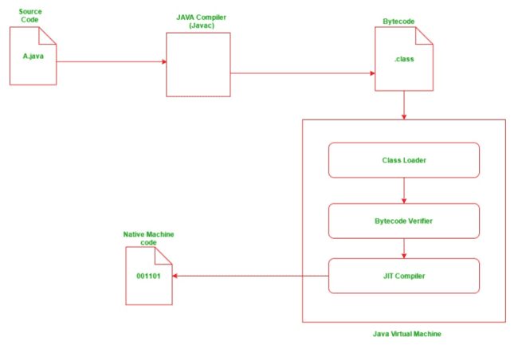
Execution

Slide 23
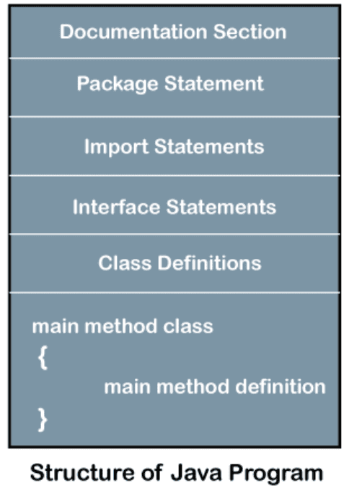
Structure of Java Program

Slide 24
Documentation Section
It is an important section but optional for a Java program.
The comments may be single-line, multi-line, and documentation comments.
Single-line Comment It starts with a pair of forwarding slash (//) // Hello VIT-AP
Multi-line Comment It starts with a /* and ends with */. We write between these two symbols.
/∗It is an example of multiline comment∗/
Documentation Comment It starts with the delimiter (/**) and ends with */.
/∗∗ I t i s an example of documentation comment∗/

Slide 25
Package Section
The package declaration is optional. It is placed just after the documentation section.
In this section, we declare the package name in which the class is placed.
Note that there can be only one package statement in a Java program. It must be defined before any class and interface declaration.
It is necessary because a Java class can be placed in different packages and directories based on the module they are used.

Slide 26
For all these classes package belongs to a single parent directory. We use the keyword package to declare the package name.
For Example
package scope; //where scope is the package name
package VIT-AP.scope;
//where VIT-AP is the root directory and scope is the subdirectory

Slide 27
Import Section
The package contains the many predefined classes and interfaces.
If we want to use any class of a particular package, we need to import that class.
The import statement represents the class stored in the other package.
We use the import keyword to import the class.
It is written before the class declaration and after the package statement.

Slide 28
We use the import statement in two ways, either import a specific class or import all classes of a particular package.
In a Java program, we can use multiple import statements.
For example:
import java.util.Scanner; //it imports the Scanner class only
import java.util.*; //it imports all the class of the java.util package

Slide 29
Interface section
It is an optional section. We can create an interface in this section if required.
We use the interface keyword to create an interface.
An interface is slightly different from the class.
It contains only constants and method declarations.
Another difference is that it cannot be instantiated.

Slide 30
We can use interface in classes by using the implements keyword.
An interface can also be used with other interfaces by using the extends keyword.
For example:
interface car
{
void start();
void stop();
}

Slide 31
Class Section
It is vital part of a Java program.
Without the class, we cannot create any Java program.
A Java program may conation more than one class definition.
We use the class keyword to define the class.
The class is a blueprint of a Java program.

Slide 32
It contains information about user-defined methods, variables, and constants.
Every Java program has at least one class that contains the main() method.
For example:
class Student //class definition
{
public static void main(String[] args)
//statements
}

Slide 33
Class Variables and Constants
In a Java program, the variables and constants are defined just after the class definition.
The variables and constants store values of the parameters.
It is used during the execution of the program.

Slide 34
We can also decide and define the scope of variables by using the modifiers.
It defines the life of the variables.
For example:
class Student //class definition
{
String sname; //variable
int id;
double percentage;
}

Slide 35
Main Method
It is essential for all Java programs.
Because the execution of all Java programs starts from the main() method.
In other words, it is an entry point of the class.
It must be inside the class.
Inside the main method, we create objects and call the methods.

Slide 36
We use the following statement to define the main() method:
public static void main(String args[])
{
}
For example:
public class Student //class definition
{
public static void main(String args[])
{
//statements
}
}

Slide 37
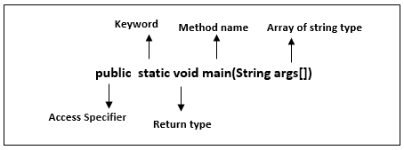
The main() is the starting point for JVM to start execution of a Java program.
Without the main() method, JVM will not execute the program.
The syntax of the main() method is:

Slide 38
public: It is an access specifier. We should use a public keyword before the main() method so that JVM can identify the execution point of the program. If we use private, protected, and default before the main() method, it will not be visible to JVM.
For Example
public class Test {
static void main(String [] args)
{
System.out.println(”Hello World”);
} }

Slide 39
static: When java runtime starts, there is no object of the class present. That’s why the main method has to be static so that JVM can load the class into memory and call the main method. If the main method won’t be static, JVM would not be able to call it because there is no object of the class is present.
For example:
public class Test { public void main(String [] args){
System.out.println(”Hello World”);
} }

Slide 40
void: In Java, every method has the return type. Void keyword acknowledges the compiler that main() method does not return any value, that’s why it’s return type is void.
For example:
public class Test { public static void main(String [] args){
return 0;
} }

Slide 41
main(): It is a default signature which is predefined in the JVM. It is called by JVM to execute a program line by line and end the execution after completion of this method.
String args[]: The main() method also accepts some data from the user. It accepts a group of strings, which is called a string array. It is used to hold the command line arguments in the form of string values.
What happens if the main() method is written without String args[]?
The program will compile, but not run, because JVM will not recognize the main() method. Remember JVM always looks for the main() method with a string type array as a parameter.

Slide 42
Java Variables
Variables are containers for storing data values. In Java, there are different types of variables
String - stores text, such as ”Hello”. String values are surrounded by double quotes
int- stores integers (whole numbers), without decimals, such as 123 or -123
float- stores floating point numbers, with decimals, such as 19.99 or -19.99
char - stores single characters, such as ’a’ or ’B’. Char values are surrounded by single quotes
boolean - stores values with two states: true or false

Slide 43
To create a variable, you must specify the type and assign it a value:
type variableName = value ;
Where type is one of Java’s types (such as int or String), and variableName is the name of the variable (such as x or name).
The equal sign is used to assign values to the variable.
To create a variable that should store text, look at the following example:
String name = ”John ”; System.out. println(name);
To create a variable that should store a number, look at the following example:
int myNum = 15; System.out. println(myNum );

Slide 44
You can also declare a variable without assigning the value, and assign the value later:
int myNum; myNum = 15;
System . out . println(myNum ) ;
Note that if you assign a new value to an existing variable, it will overwrite the previous value:
int myNum = 15; myNum = 20; // myNum is now 20
System . out . println(myNum);

Slide 45
To declare more than one variable of the same type, you can use a comma-separated list
int x = 5, y = 6, z = 50; System.out.println(x + y + z);
One Value to Multiple Variables
int x,y,z; x = y = z = 50; System.out.println(x + y + z);
A demonstration of how to declare variables of other types:
int myNum = 5;
float myFloatNum = 5.99f;
char myLetter = ’D’ ;
boolean myBool = true ;
String myText = ”Hello ”;

Slide 46
General Rules for Declaring variables
Names can contain letters, digits, underscores, and dollar signs
Names must begin with a letter
Names should start with a lowercase letter and it cannot contain whitespace
Names can also begin with dollar and underscore
Names are case sensitive (”myVar” and ”myvar” are different variables)
Reserved words (like Java keywords, such as int or boolean) cannot be used as names

Slide 47
Types of variables
There are three types of variables in java:
local variable:
A variable declared inside the body of the method is called local variable.
Instance variable:
A variable declared inside the class but outside the body of the method, is called instance variable.
Static variable/Class Variable
A variable which is declared as static is called static variable. It cannot be local. You can create a single copy of static variable and share among all the instances of the class. Memory allocation for static variable happens only once when the class is loaded in the memory.

Slide 48
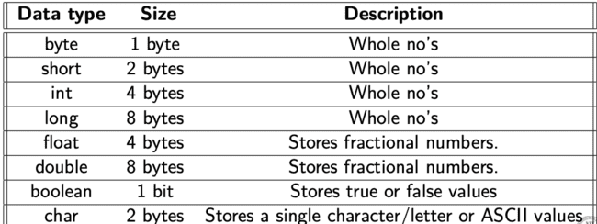
Data Types
Data types are divided into two groups:
Primitive data types - includes byte, short, int, long, float, double, boolean and char Non-primitive data types - such as String, Arrays and Classes

Slide 49
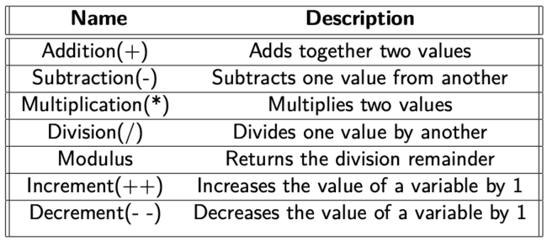
Java Operators
Arithmetic Operators

Slide 50
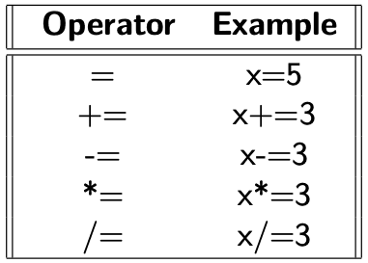
Assignment Operators
Example
int x = 10;
x += 5;

Slide 51
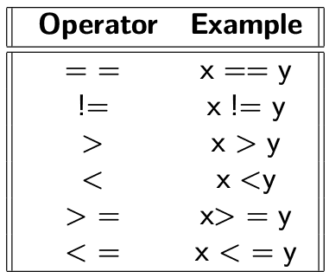
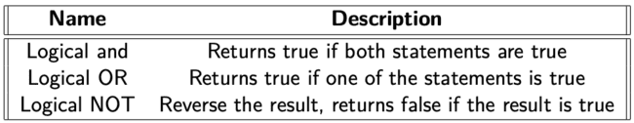
Comparison Operators
Logical Operators
For Example
x<5 && x<10
x<5||x<4
!(x < 5 && x < 10)

Slide 52
Work-1
Write a Java program with and without a main method and understand its outcome.
Write a Java program to print Hello World as output.
Write a Java program to add numbers using multiple variables.
Write a java program to print the reverse of given input string.

Slide 53
Sample Java Program
/*Program name: Palindrome*/
//Author's name: Mathew
/*Palindrome is number or string that will remains the same
When we write that in reverse order. Some example of
palindrome is 393, 010, madam, etc.*/
//imports the Scanner class of the java.util package
import java.util.Scanner;
//class definition
public class CheckPalindromeNumber
{
//main method
}
public static void main(String args[])
{
//variables to be used in program
int r, s=0, temp;
int x; //It is the number variable to be checked for palindrome
Scanner sc=new Scanner(System.in);
System.out.println("Enter the number to check: ");
//reading a number from the user
x=sc.nextInt();
//logic to check if the number id palindrome or not
temp=x;
while(x>0)
{
r=x%10; //finds remainder
s=(s*10)+r;
x=x/10;
}
if(temp==s)
System.out.println("The given number is palindrome.");
else
System.out.println("The given number is not palindrome.");
}
Output:
Enter the Number to check: 121
The given number is palindrome

Slide 54
Applications
There are many devices where Java is currently used.
Some of them are as follows:
Desktop Applications such as acrobat reader, media player, antivirus, etc.
Web Applications such as irctc.co.in, javatpoint.com, etc.
Enterprise Applications such as banking applications.
Mobile
Games, etc.

Slide 55
Classes and Objects
Object-oriented programming has several advantages over procedural programming
OOP is faster and easier to execute
OOP provides a clear structure for the programs
OOP helps to keep the Java code DRY ”Don’t Repeat Yourself”, and makes the code easier to maintain, modify and debug.
OOP makes it possible to create full reusable applications with less code and shorter development time

Slide 56
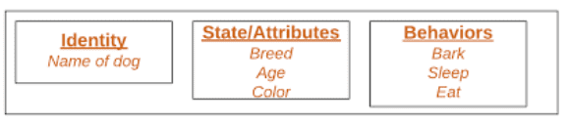
Classes and objects are the two main aspects of object-oriented programming
A class is a template for objects, and an object is an instance of a class.

Slide 57
Create an object
In Java, an object is created from a class.
Syntax for creation of an Object in Java
ClassName object = new ClassName ();
To create an object of Main, specify the class name, followed by the object name, and use the keyword new
Example
public class VIT {
int x=5;
public static void main(String [] args)
{
VIT myObj = new VIT ( ) ;
System.out. println(myObj.x);
} }
Output: 5

Slide 58
Multiple Objects
public class Main {
int x=5;
public static void main(String [] args) {
Main myObj1 = new Main(); // Object 1
Main myObj2 = new Main(); // Object 2
System.out. println(myObj1.x);
System.out. println(myObj2.x);
} }
Output:
5
5

Slide 59
Using Multiple classes
You can also create an object of a class and access it in another class.
This is often used for better organization of classes (one class has all the attributes and methods, while the other class holds the main() method (code to be executed)).
Main.java
public class Main {
int x=5;
}
Second.java
class Second { public static void main(String [] args) {
Main myObj = new Main ( ) ;
System.out. println(myObj.x);
}
Output: 5

Slide 60
Java Class Attributes
Example for declaration of variables in class
public class Main {
int x=5; int y=3;
}
Accessing Attributes The following example will create an object of the Main class, with the name myObj.
We use the x attribute on the object to print its value:
public class Main {
int x = 5;
public static void main(String[] args) {
Main myObj = new Main();
System.out.println(myObj.x);
}}

Slide 61
Modifying attributes
public class Main {
int x = 10;
public static void main(String [] args) {
Main myObj = new Main ( ) ;
myObj.x = 25; // x is now 25
System.out. println(myObj.x);
} }
Output:
25

Slide 62
If we don’t want the ability to override existing values, declare the attribute as final
Example
public class Main {
final int x = 10;
public static void main(String [] args) {
Main myObj = new Main ( ) ;
myObj.x = 25; // will generate an error : cannot be assigned
System.out. println(myObj.x);
} }

Slide 63
Multiple ObJects
If you create multiple objects of one class, you can change the attribute values in one object, without affecting the attribute values in the other
Example
Change the value of x to 25 in myObj2, and leave x in myObj1 unchanged:
public class Main { int x=5; public static void main(String [] args) {
Main myObj1 = new Main(); // Object 1 Main myObj2 = new Main(); // Object 2
myObj2.x = 25; System.out.println(myObj1.x); // Outputs 5
System.out.println(myObj2.x); // Outputs 25
} }

Slide 64
We can specify as many attributes as we want
public class Main {
String fname = "John";
String lname = "Doe";
int age = 24;
public static void main(String[] args) {
Main myObj = new Main();
System.out.println("Name: " + myObj.fname + " " + myObj.lname);
System.out.println("Age: " + myObj.age);
} }
Output:
Name: John Doe
Age: 24

Slide 65
Java methods
A method is a block of code which only runs when it is called.
You can pass data, known as parameters, into a method.
Methods are used to perform certain actions, and they are also known as functions.
Why use methods? To reuse code: define the code once, and use it many times.

Slide 66
Call a method
To call a method in Java, write the method's name followed by two parentheses () and a semicolon;
In the following example, myMethod(); is used to print a text (the action), when it is called:
public class Main {
static void myMethod() {
System.out.println("I just got executed!");
}
public static void main(String[] args) {
myMethod();
} }
Output:
I just got executed

Slide 67
A method can also be called multiple times:
Example:
public class Main {
static void myMethod() {
System.out.println("I just got executed!");
}
public static void main(String[] args)
{
myMethod();
myMethod();
myMethod();
} }
Output:
I just got executed!
I just got executed!
I just got executed!

Slide 68
Static and non-Static Methods
public class Main {
static void myStaticMethod() {
System.out.println("Static Methods"); //In static method no need to create an object for achieving output
}
public void myPublicMethod() {
System.out.println("Non Public Methods");
}
public static void main(String[] args)
{
myStaticMethod();
Main myObj = new Main();
myObj.myPublicMethod(); //In public method output will be executed only when object is created
} }
Output:
Static Methods
Non Public Methods

Slide 69
Access methods with an object
public class Main {
public void fullThrottle() {
System.out.println("The car is going fast");
}
public void speed(int maxSpeed) {
System.out.println("Max speed is: " + maxSpeed);
}
public static void main(String [] args) {
Main myCar = new Main ( );
myCar. fullThrottle ();
myCar . speed (200);
} }
Output:
The car is going fast
Max speed is: 200

Slide 70
Java Constructors
A constructor in Java is a special method that is used to initialize objects.
The constructor is called when an object of a class is created.
It can be used to set initial values for object attributes.
public class Main {
int x;
public Main() { //constructor
x=5;
} public static void main(String [] args) {
Main myObj = new Main ( ) ;
System.out. println(myObj.x);
} }
Output:
5

Slide 71
The parameterized constructors are the constructors having a specific number of arguments to be passed.
The purpose of a parameterized constructor is to assign user-wanted specific values to the instance variables of different objects.
A parameterized constructor is written explicitly by a programmer.

Slide 72
Note that the constructor name must match the class name, and it cannot have a return type (like void).
Also note that the constructor is called when the object is created.
Constructor Parameters
public class Main {
int x;
public Main( int y) { //parameterised constructors
x=y;
} public static void main(String [] args) {
Main myObj = new Main (5);
System.out. println(myObj.x);
} }
Output:
5

Slide 73
You can have as many parameters as you want in constructors
Example:
public class Main { int modelYear ; String modelName; public Main(int year , String name) //Parameterised constructor
{
modelYear = year ;
modelName = name; } public static void main(String [] args) {
Main myCar = new Main(1969 , ”Mustang ”);
System.out.println(myCar.modelYear + ” ”+myCar.modelName);
} }

Slide 74
Example
public class Student {
int roll_no; String stu_name;
Student(int i, String n) { // Parameterized constructor
roll_no = i; stu_name = n; }
void display() { System.out.println(roll_no+" "+stu_name); }
public static void main(String args[]) {
Student s1 = new Student(1,"Adithya");
Student s2 = new Student(2,"Jai");
s1.display();
s2.display(); } }

Slide 75
Programs on Constructor
1. Write a java program that calculates the perimeter and area of rectangle for given length and width, use constructor to set length and width.
2. Design and write a class to represent a bank account that includes the following members:
a. Data members
Owner name
Account number
Balance amount in the account
b. Methods members
To assign initial values
To deposit an amount
To withdraw an amount after checking balance
To display the owner name and balance

Slide 76
3.a. Write a program to print the names of students by creating a Student class. If no name is passed while creating an object of Student class, then the name should be "Unknown", otherwise the name should be equal to the String value passed while creating object of Student class.
b. Create a class named 'Programming'. While creating an object of the class, if nothing is passed to it, then the message "I love programming languages" should be printed. If some String is passed to it, then in place of "programming languages" the name of that String variable should be printed. For example, while creating object if we pass "Java", then "I love Java" should be printed.
4. Suppose you have a Piggie Bank with an initial amount of $50 and you have to add some more amount to it. Create a class 'AddAmount' with a data member named 'amount' with an initial value of $50. Now make two constructors of this class as follows:
1 - without any parameter - no amount will be added to the Piggie Bank 2 - having a parameter which is the amount that will be added to Piggie Bank Create object of the 'AddAmount' class and display the final amount in Piggie Bank.

Slide 77
Access Specifiers (AS)
The access modifiers in Java specifies the accessibility or scope of a field, method, constructor, or class.
There are four types of Java access specifiers:
- Public : accessible from everywhere
- Private : accessible within the same class only
- Default : accessible by the classes of the same package
- Protected : accessible by the classes of the same package and the
subclasses residing in any package
The access specifiers can be strictly ordered:
public > protected > default > private

Slide 78
AS for Classes
public- The class is accessible by any other class
public class Main { public static void main(String [] args) {
System.out.println(”Hello World”);
} }
default- The class is only accessible by classes in the same package. This is used when you don’t specify a specifier/modifier.
class MyClass { public static void main(String [] args) {
System.out.println(”Hello World”);
} }

Slide 79
AS for attributes, methods & Constructors
public-The code is accessible for all classes
public class Main {
public String fname = ”John ”; public String lname = ”Doe”; pubic String email = ”john@doe .com”; int age = 24;
} class Second1 {
public static void main(String [] args) { Main myObj = new Main ( ) ; System.out.println(”Name: ” + myObj.fname + ” ” + System.out.println(”Email: ” + myObj.email); System.out.println(”Age: ” + myObj.age);
}
}

Slide 80
private-The code is only accessible within the declared class
public class Main { private String fname = ”John”; private String lname = ”Doe”; private String email = ”john@doe .com”;
private int age = 24;
} class test{
public static void main(String [] args) { Main myObj = new Main ( ) ; System.out.println(”Name: ” + myObj.fname + ” ” + System.out.println(”Email: ” + myObj.email); System.out.println(”Age: ” + myObj.age);
}
}

Slide 81
Protected-The code is accessible in the same package and subclasses.
class Person { protected String fname = ”John ”;
protected String lname = ”Doe”; protected String email = ”john@doe .com”;
protected int age = 24;
} class Student extends Person {
private int graduationYear = 2018; public static void main(String [] args) {
Student myObj = new Student ( ) ;

Slide 82
System.out.println(”Name: ” + myObj.fname + ” ” + myOb System.out.println(”Email: ” + myObj.email); System.out.println(”Age: ” + myObj.age); System.out.println(”Graduation Year: ” + myObj.gra
} }

Slide 83
default-The code is only accessible in the same package. This is used when you don’t specify a modifier. You don’t need to specify any keyword for this. It is created by JVM itself.
class Person { String fname = ”John ”; String lname = ”Doe”; String email = ”john@doe .com”; int age = 24;
public static void main(String [] args) { Person Ob = new Person(); System.out.println(”Name: ” +Ob.fname +” ”+Ob.lnam System.out.println(”Email: ” +Ob.email); System.out.println(”Age: ” +Ob.age);
}
}

Slide 84
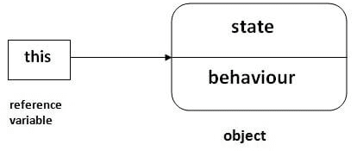
This Keyword
There can be a lot of usage of Java this keyword. In Java, this is a reference variable that refers to the current object.

Slide 85
without this keyword
class Student{ //class definition
int rollno; // Instance variable 1
String name; // Instance variable 2
float fee; // Instance variable 3
Student (int rollno,String name,float fee)
{
rollno=rollno; // local variable 1
name=name; //local variable 2
fee=fee; // local variable 3
}
void display(){
System.out.println(rollno+" "+name+" "+fee);}
}
class TestThis1{
public static void main(String args[]){
Student s1=new Student(111,"ankit",5000f);
Student s2=new Student(112,"sumit",6000f);
s1.display();
s2.display();
}}
Output:
0 null 0.0
0 null 0.0

Slide 86
In the previous example, parameters (formal arguments) and instance variables are same. So, we are using this keyword to distinguish local variable and instance variable.
Local variables: Variables defined inside methods, constructors or blocks are called local variables. The variable will be declared and initialized within the method and the variable will be destroyed when the method has completed.
Instance variables Instance variables are variables within a class but outside any method. These variables are initialized when the class is instantiated. Instance variables can be accessed from inside any method, constructor or blocks of that particular class.

Slide 87
Understanding variables
public class A //class definition
{
static int m=100; //static or instance variable
void method()
{
int n=90; // local variable
}
public static void main(String args[])
{
int data=50;//instance variable
}
}//end of class

Slide 88
With This Keyword
If local variables(formal arguments) and instance variables are different, there is no need to use this keyword
class Student{
int rollno; //instance variable1
String name; //instance variable 2
float fee; //instance variable 3
Student(int rollno,String name,float fee){
this.rollno=rollno; // local/formal argument 1
this.name=name; // local/formal argument 2
this.fee=fee; //local/formal argument 3
}
void display(){System.out.println(rollno+" "+name+" "+fee); }
}
class TestThis2{
public static void main(String args[]){
Student s1=new Student(111,"ankit",5000f);
Student s2=new Student(112,"sumit",6000f);
s1.display();
s2.display();
}}
Output:
111 ankit 5000.0
112 sumit 6000.0

Slide 89
If local variables(formal arguments) and instance variables are different, there is no need to use this keyword
class Student{
int rollno;
String name;
float fee;
Student(int r,String n,float f){
rollno=r;
name=n;
fee=f;
}
void display(){ System.out.println(rollno+" "+name+" "+fee);}
}
class TestThis3{
public static void main(String args[]){
Student s1=new Student(111,"ankit",5000f);
Student s2=new Student(112,"sumit",6000f);
s1.display();
s2.display();
}}
Output:
111 ankit 5000.0
112 sumit 6000.0

Slide 90

Encapsulation
Encapsulation is defined as the wrapping up of data under a single unit.
It is the mechanism that binds together code and the data it manipulates.
Technically in encapsulation, the variables or data of a class is hidden from any other class and can be accessed only through any member function of its own class in which it is declared.
Encapsulation can be achieved by Declaring all the variables in the class as private and writing public methods in the class to set and get the values of variables
It is more defined with setter and getter method.

Slide 91
Example
// get method for age to access
// private variable geekAge
public int getAge() {; return geekAge }
// get method for name to access
// private variable geekName
public String getName() { return geekName; }
// get method for roll to access
// private variable geekRoll
public int getRoll() { return geekRoll; }
// set method for age to access
// private variable geekage
// Java program to demonstrate encapsulation
class Encapsulate {
// private variables declared
// these can only be accessed by
// public methods of class
private String geekName;
private int geekRoll;
private int geekAge;

Slide 92
Example contd...
public void setAge(int newAge) { geekAge = newAge; }
// set method for name to access
// private variable geekName
public void setName(String newName)
{
geekName = newName;
}
// set method for roll to access
// private variable geekRoll
public void setRoll(int newRoll) { geekRoll = newRoll; }
}

Slide 93
Example contd...
In the below program, the class Encapsulate is encapsulated as the variables are declared as private. The get methods like getAge() , getName() , getRoll() are set as public, these methods are used to access these variables. The setter methods like setName(), setAge(), setRoll() are also declared as public and are used to set the values of the variables.
public class TestEncapsulation {
public static void main(String[] args)
{
Encapsulate obj = new Encapsulate();
// setting values of the variables
obj.setName("Harsh");
obj.setAge(19);
obj.setRoll(51);
// Displaying values of the variables
System.out.println("Geek's name: " + obj.getName());
System.out.println("Geek's age: " + obj.getAge());
System.out.println("Geek's roll: " + obj.getRoll());
// Direct access of geekRoll is not possible
// due to encapsulation
// System.out.println("Geek's roll: " +
// obj.geekName);
}
}
Output:
Geek's name: Harsh
Geek's age: 19
Geek's roll: 51

Slide 94
Inheritance
Inheritance is an important pillar of OOP(Object-Oriented Programming).
It is the mechanism in java by which one class is allowed to inherit the features(fields and methods) of another class.
Super Class: The class whose features are inherited is known as superclass.
Sub Class: The class that inherits the other class is known as a subclass(or a derived class, extended class, or child class). The subclass can add its own fields and methods in addition to the superclass fields and methods.

Slide 95
Reusability: Inheritance supports the concept of “reusability”, i.e. when we want to create a new class and there is already a class that includes some of the code that we want, we can derive our new class from the existing class.
The keyword used for inheritance is extends.
class base-class{
{ //methods and fields. }
class derived−class1 extends base−class
{
//methods and fields
}
Class derived-class2 extends derived-class1
{ }

Slide 96
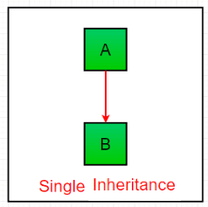
Single Inheritance

Slide 97
class one {
public void geek()
{
System . out . println (” Sai ”);
} }
class two extends one {
public void home()
System . out . println (” for ”);
} }
public class Main { public static void main(String [] args)
{
} }
two g = new two();
g. print geek (); g. print for (); g. print geek ();

Slide 98
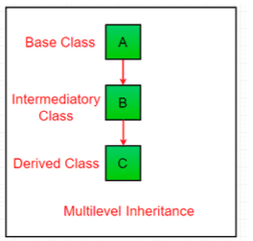
Multilevel inheritance

Slide 99
class one { public void print geek ()
{
System.out.println(” Sudheer ” ) ;
} }
class two extends one { public void print for () {
System . out . println (” for ”);
} }
class three extends two { public void print geek ()
{
} }
} }
System . out . p r i n t l n (” Suneetha ” ) ;
public class Main { public static void main(String [] args)
{
three g = new three (); g. print geek (); g. print for (); g. print geek ();

Slide 100
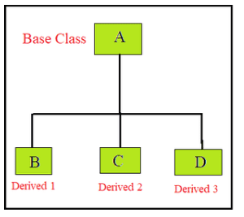
Hierarchical Inheritance

Slide 101
class A { public void print A ()
{
System.out.println(”Class A”);
} }
class B extends A { public void print B ()
{
System.out.println(”Class B”);
} }
class C extends A { public void print C ()
{
} }
class D extends A
{
public void print D () { System.out.println(”Class D”);
} }
public class Test { public static void main(String []
args)
} }
{
B obj B = new B(); obj B.print A(); obj B.print B();
C obj C = new C(); obj C.print A(); obj C.print C();
D obj D = new D(); obj D.print A(); obj D.print D();

Slide 102
Super Keyword
The super keyword in java is a reference variable that is used to refer parent class objects.
Use of super with variables: This scenario occurs when a derived class and base class has same data members. In that case there is a possibility of ambiguity for the JVM.
void display ()
{
System.out.println(”Maximum Speed:” + super.maxSpeed);
} }
class Test
{
public static void main(String [] args]
{
Car small = new Car(); small . display (); }}
class Vehicle
{
}
int maxSpeed = 120;
class Car extends Vehicle
{
int maxSpeed = 180;

Slide 103
Use of super with methods: This is used when we want to call parent class method. So whenever a parent and child class have same named methods then to resolve ambiguity we use super keyword.
class Person
{ void message (){ System.out.println(”This is person class”); }} class Student extends Person{ void message () { System.out.println(”This is student class”); }
void display ()
{
message ( ) ; super . message ();
} }
class Test
{
public static void main(String args [])
{
Student s = new Student(); s.display();
} }

Slide 104
Use of super with constructors: super keyword can also be used to access the parent class constructor.
class Person { Person (){ System.out.println(”Person class Constructor”); }} class Student extends Person { Student ()
System.out.println(”Student class Constructor”); {
}
super (); }
class Test
{{
public static void main(String [] args)
Student s = new Student(); }}

Slide 105
Final Keyword
final applied to variables
class Bike9{ final int speedlimit=90; //final variable
void run (){
speedlimit =400;
} public static void main(String args []){
Bike9 obj=new Bike9(); obj . run ();
} }

Slide 106
final applied for method
class Bike{ final void run(){
System.out.println(”running”);}
} class Honda extends Bike{
void run(){System.out.println(”running safely with
public static void main(String args []){
Honda honda= new Honda ( ) ; honda . run ( ) ; }
}

Slide 107
final applied for class
final class Bike{} class Honda1 extends Bike{
void run(){
System.out.println(”running safely with 1”);
public static void main(String args []){
Honda1 honda= new Honda1 ( ) ; honda . run ( ) ; }
}

Slide 108
Object Oriented Programming (OOP) Course Code: CSE2005/SWE2005
MODULE – 2
(Polymorphism, Packages & Interfaces)
By:
Dr. Nagendra Panini Challa
Assistant Professor, Senior Grade 2
SCOPE, VIT-AP University, India

Slide 109
Agenda
Polymorphism
Dynamic Binding
Method Overriding
Abstraction
Abstraction classes and methods
The Object Class
Packages
Interfaces
Object cloning
Inner Classes
Garbage Collection
Finalize Method
Interfaces
Abstract Classes
Define an Interface
Implementing Interfaces
Extending Interfaces

Slide 110
Polymorphism
Polymorphism in Java can perform a single action in different ways.
Polymorphism is derived from 2 Greek words: poly and morphs.
The word ”poly” means many and ”morphs” means forms. So polymorphism means many forms.
There are two types of polymorphism in Java: compile-time polymorphism and runtime polymorphism
We can perform polymorphism in java by method overloading and method overriding.

Slide 111
Method Overloading
If a class has multiple methods having same name but different in parameters, it is known as Method Overloading.
If we have to perform only one operation, having same name of the methods increases the readability of the program.
Suppose, you have to perform the addition of given numbers but there can be any number of arguments.
In order to accomplish the task, you can create two methods sum2num(int, int) and sum3num(int, int, int) for two and three parameters respectively.
other programmers, as well as you in the future may get confused as the behaviour of both methods are the same but they differ by name.
The better way to accomplish this task is by overloading methods. Depending upon the argument passed, one of the overloaded methods is called.

Slide 112
Advantage of Method Overloading
Method overloading increases the readability of the program.
Different ways to overload the method
There are two ways to overload the method in java
By changing number of arguments.
By changing the data type
In Java, Method Overloading is not possible by changing the return type of the method only.

Slide 113
public class Sum {
public int sum(int x, int y)
{
return (x + y);
}
public int sum(int x, int y, int z)
{
return(x+y+z);
}
public double sum(double x, double y)
{
return (x + y);
}
public static void main(String args [])
{
Sum s = new Sum();
System.out.println(s.sum(10, 20)); System.out.println(s.sum(10, 20, 30)); System.out.println(s.sum(10.5, 20.5));
} }
Output:
30
60
31

Slide 114
changing number of parameters
class MethodOverloading { private static void display(int a){
System.out.println(”Arguments: ” + a);
} private static void display(int a, int b){
System.out.println(”Arguments: ” + a + ” and ” + b);
} public static void main(String [] args) {
display (1);
display(1, 4);
} }
Output:
Arguments: 1
Arguments 1 and 4

Slide 115
changing datatype of parameters
class MethodOverloading1 { private static void display(int a){
System.out.println(”Got Integer data.”);
} private static void display(String a){
System.out.println(”Got String object.”);
} public static void main(String [] args) {
display (1);
display (” Hello ”);
} }
Output:
Got Integer Data
Got String object

Slide 116
Method Overloading is not possible by changing the return type of method.
class Adder{ static int add(int a, int b){
return a+b;}
static double add(int a, int b, int c){
return a+b;}
} class TestOverloading3{ public static void main(String [] args){
Adder A=new Adder();
System.out. println(A.add(11,11)); //ambiguity
}}
Output:
Duplicate method have same add (int,int) ambiguity

Slide 117
Overloading of main method
Can we overload java main() method?
Yes, by method overloading. You can have any number of main methods in a class by method overloading. But JVM calls main() method which receives string array as arguments only.
class TestOverloading4{ public static void main(String [] args){
System.out.println(”main with String[]”);
} public static void main(String args){
System . out . println (”main with String ”);
} public static void main(){ System . out . println (”main without args ”);
} }
Output:
main with String[]

Slide 118
Overloading of static methods
We can have two or more static methods with the same name, but differences in input parameters. We cannot overload two methods in java if they only differ by static keyword
public class Test { public static void foo() {
System.out.println(”Test.foo() called ”);
} public static void foo(int a) {
System.out.println(”Test.foo(int) called ”);
}
public static void main(String args [])
{
foo ();
foo (10); } }

Slide 119
Method Overriding
If subclass (child class) has the same method as declared in the parent class, it is known as method overriding in Java.
Method overriding is used to provide the specific implementation of a method which is already provided by its superclass.
Method overriding is used for runtime polymorphism

Slide 120
Rules for Method Overriding
The method must have the same name as in the parent class
The method must have the same parameter as in the parent class.
There must be an IS-A relationship (inheritance).
class Vehicle{ void run () { System.out.println(”Vehicle is running”); }
} class Bike2 extends Vehicle{
void run (){
System.out.println(”Bike is running safely”);
}
public static void main(String args [])
Vehicle obj = new Bike2(); obj . run (); }
}
{
Output:
Bike is running safely

Slide 121
class Parent { static/final/private void show() { System.out.println(”Parent’s show()”);
}
} class Child extends Parent {
static/final/private void show()
{
System.out.println(”Child’s show()”);
} }
class Main { public static void main(String [] args)
{
// If a Parent type reference refers to a Parent object , then Parent ’ s
// show is called
Parent obj1 = new Parent();
obj1. show ( );
// If a Parent type reference refers to a Child object Child’s show() // is called . This is called RUN TIME POLYMORPHISM.
Parent obj2 = new Child (); obj2 . show ( ) ; } }
Output:
Parent’s show
Child’s show

Slide 122
Static and Dynamic Binding
Association of method call to the method body is known as binding.
There are two types of binding: Static Binding that happens at compile time and Dynamic Binding that happens at runtime.
What is reference and Object
class Human{ }
class Boy extends Human{ public static void main( String args[]) {
/∗This statement simply creates an object of class ∗Boy and assigns a reference of Boy to it∗/
Boy obj1 = new Boy();
/∗ Since Boy extends Human class. The object creation ∗can be done in this way. Parent class reference ∗ can have child class reference assigned to it∗/
Human obj2 = new Boy(); }}
The binding which can be resolved at compile time by compiler is known as static or early binding.
The binding of static, private and final methods is compile-time. Why?
The reason is that the these method cannot be overridden and the type of the class is determined at the compile time.

Slide 123
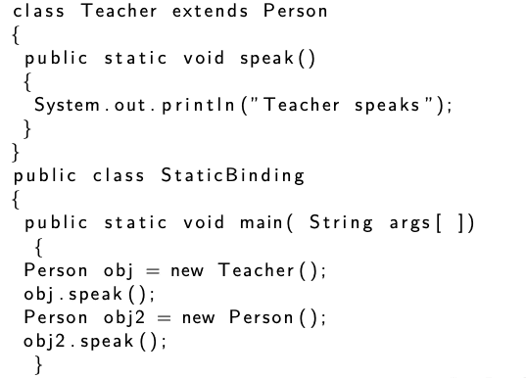
class Person
{
public static void speak()
{
System.out.println(”Person speaks”);
} }
Output:
Person speaks
Person speaks
From the above code, we got the same output from the parent class.
This happened because:
The reference for the parent class and the child class is the same(Person). That is, a single object refers to both of them.
Since the method is static, the compiler is aware that this method can not be overridden in the child class and it knows which method to call.
Therefore there is no ambiguity and the output is the same for both cases.
}

Slide 124
Dynamic Binding
public class DynamicBinding
{
public static void main( String args [])
{
Person obj2 = new Person();
obj2 . speak (); Person obj = new Teacher ();
obj . speak ();
} }
class Person
{
public void speak ()
{
System.out.println(”Person speaks”);
} }
class Teacher extends Person
{
public void speak ()
{
} }
System.out.println(”Teacher speaks”);
Output:
Person speaks
Teacher speaks
From the above code, we got different output because: We have not declared the methods as static in the code.
During compilation, the compiler has no idea of which method to call. This happens because the compiler doesn’t go according to the type of the object but it checks only according to the reference variable.
Therefore the binding gets delayed to runtime, so the respective version of the speak() method will be called on the basis of the type of the object.

Slide 125
Example - SB
// Static nested inner class
// Class 2
public static class subclass extends superclass {
// Method of inner class
static void print()
{
// print statement
System.out.println(
"print() in subclass is called");
}
}
// Method of main class
// Main driver method
public static void main(String[] args)
{
// Java Program to Illustrate Static Binding
// Main class
class NewClass {
// Static nested inner class
// Class 1
public static class superclass {
// Method of inner class
static void print()
{
// Print statement
System.out.println(
"print() in superclass is called");
}
}
// Creating objects of static inner classes
// inside main() method
superclass A = new superclass();
superclass B = new subclass();
// Calling method over above objects
A.print();
B.print();
}
}

Slide 126
Output
print() in superclass is called
print() in superclass is called
Output Explanation: As you can see, in both cases the print method of the superclass is called. Let us discuss how this happens
We have created one object of subclass and one object of the superclass with the reference of the superclass.
Since the print method of the superclass is static, the compiler knows that it will not be overridden in subclasses and hence compiler knows during compile time which print method to call and hence no ambiguity.
As an exercise, the reader can change the reference of object B to subclass and then check the output.

Slide 127
Example - DB
// Method of inner class 2
@Override void print()
{
// Print statement
System.out.println(
"print in subclass is called");
}
}
// Method inside main class
public static void main(String[] args)
{
// Creating object of inner class 1
// with reference to constructor of super class
superclass A = new superclass();
// Creating object of inner class 1
// with reference to constructor of sub class
superclass B = new subclass();
// Calling print() method over above objects
A.print();
B.print();
}
}
// Java Program to Illustrate Dynamic Binding
// Main class
public class GFG {
// Static nested inner class
// Class 1
public static class superclass {
// Method of inner class 1
void print()
{
// Print statement
System.out.println(
"print in superclass is called");
}
}
// Static nested inner class
// Class 2
public static class subclass extends superclass {

Slide 128
Output
print in superclass is called
print in subclass is called
Output Explanation: Here the output differs. But why? Let’s break down the code and understand it thoroughly.
Methods are not static in this code.
During compilation, the compiler has no idea as to which print has to be called since the compiler goes only by referencing variable not by the type of object, and therefore the binding would be delayed to runtime and therefore the corresponding version of the print will be called based on type on an object.

Slide 129
Abstraction
The extent to which a module hides its internal data and other implementation details from the other modules is the most important factor that distinguishes a well-designed Object-Oriented module from other modules.
A well-designed module hides all of its implementation details and cleanly separates its interface from its implementation.
These modules then communicate with each other only through the interfaces.
This concept is supported with the help of Abstraction in Java.
The meaning of the word “Abstraction”, in general words, is the process of working with ideas rather than their implementation.

Slide 130
For example, consider the example of an email, the user does not know about the complex details such as what happens just after sending an email, which protocol is used by the server to send the message.
Therefore, we just need to mention the address of the receiver, type the content and click the send button.
This is basically called Abstraction in which the complex details are being hidden from the users.
Similarly, in Object-oriented programming, abstraction is a process of providing functionality to the users by hiding its implementation details from them.
In other words, the user will have just the knowledge of what an entity is doing instead of its internal working.

Slide 131
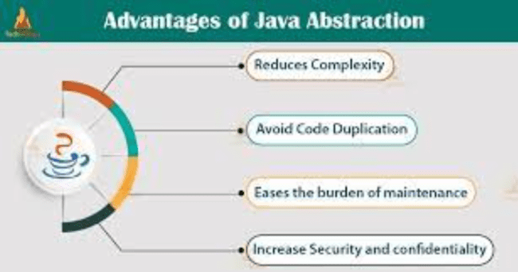

Slide 132
An Abstraction is a process of exposing all the necessary details and hiding the rest.
Abstraction defines an object in terms of its properties (attributes), behavior (methods), and interfaces (means of communicating with other objects).
Abstraction can be seen as the technique of filtering out the unnecessary details of an object so that there remain only the useful characteristics that define it.
Abstraction focuses on the perceived behavior of the entity. It provides an external view of the entity.
Real-life Example for Java Abstraction If we want to process something from the real world, we have to extract the essential characteristics of that object.

Slide 133
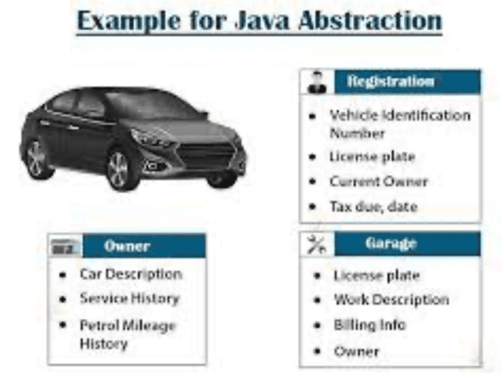

Slide 134
How to Achieve Abstraction in Java?
In Java, we can achieve Data Abstraction using
1) Abstract classes and
2) Interfaces.
Interfaces allow 100 percent abstraction (complete abstraction). Interfaces allow you to abstract the implementation completely.
Abstract classes allow 0 to 100 percent abstraction (partial to complete abstraction) because abstract classes can contain concrete methods that have the implementation which results in a partial abstraction.

Slide 135
Abstract classes in Java
An Abstract class is a class whose objects can’t be created. An Abstract class is created through the use of the abstract keyword. It is used to represent a concept.
An abstract class can have abstract methods (methods without body) as well as non-abstract methods or concrete methods (methods with the body). A non-abstract class cannot have abstract methods.
The class has to be declared as abstract if it contains at least one abstract method.
An abstract class does not allow you to create objects of its type. In this case, we can only use the objects of its subclass.
Using an abstract class, we can achieve 0 to 100percent abstraction. The abstract class can also contain final and static methods.

Slide 136
Syntax of declaring an abstract class
abstract class ClassName
{
//class body // has atleast one abstract method.
}

Slide 137
Abstract methods in Java
Abstract methods are methods with no implementation and without a method body. They do not contain any method statement.
An abstract method is declared with an abstract keyword.
The declaration of an abstract method must end with a semicolon ;
The child classes which inherit the abstract class must provide the implementation of these inherited abstract methods.
Syntax of declaring an abstract method
access−specifier abstract return−type method−name();

Slide 138
Example
public void show2()
{ System . out . p r i n t l n (” show2 ” ) ; }
}
public class AbstractionDemo
{
{
public static void main(String [] args)
ChildClass obj = new ChildClass ();
o b j . show1 ( ) ; o b j . show2 ( ) ; }
abstract class BaseClass
{
abstract public void show1(); // abstract method
public void show2() // non-abstract/concrete method
{ System.out.println(”Concrete method ”);
}
}
class ChildClass extends BaseClass
{
public void show1()
{
System . out . p r i n t l n (” show1 ” ) ;
} }
Output:
show1
show2

Slide 139
Example
public class AbstractionDemo1
{
public static void main(String args [])
{
} }
ParentClass obj = new ParentClass ();
obj . showDetails ();
abstract class ParentClass
{
abstract public void showDetails ();
}
class ChildClass extends ParentClass
{
public void showDetails ()
{
System . out . print (” Abstract method ”);
} }
Output:
Error is occurred

Slide 140
Interface
An interface in Java is a blueprint of a class. It has static constants and abstract methods.
The interface in Java is a mechanism to achieve abstraction.
There can be only abstract methods in the Java interface, not method body.
It is used to achieve abstraction and multiple inheritance in Java.
In other words, you can say that interfaces can have abstract methods and variables. It cannot have a method body.
It cannot be instantiated just like the abstract class.

Slide 141
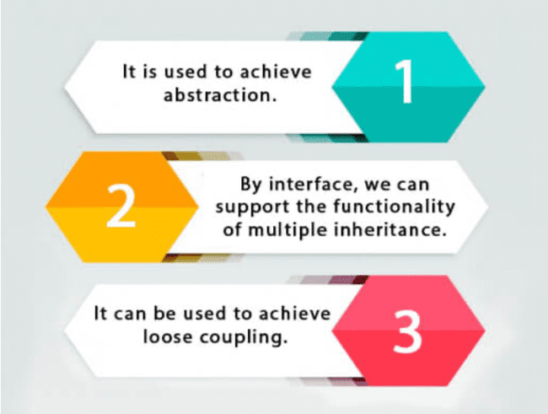

Slide 142
How to declare an interface?
An interface is declared by using the interface keyword.
It provides total abstraction; means all the methods in an interface are declared with the empty body, and all the fields are public, static and final by default.
A class that implements an interface must implement all the methods declared in the interface.
interface <interface name>
{ // declare constant fields // declare methods that abstract
// by default. }

Slide 143
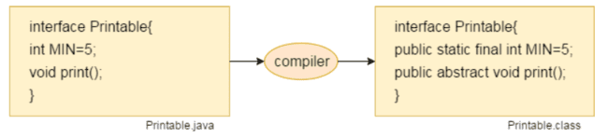
Internal addition by the compiler
The Java compiler adds public and abstract keywords before the interface method.
Moreover, it adds public, static and final keywords before data members.
In other words, Interface fields are public, static and final by default, and the methods are public and abstract.

Slide 144
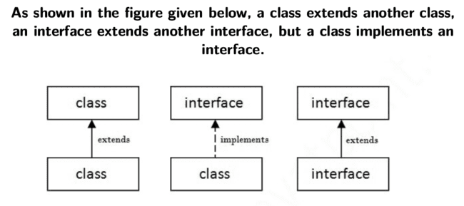
The relationship between classes and interfaces

Slide 145
Java Interface Example
Output:
Hello
interface printable{ //interface definition void print (); //abstract method } class X implements printable{ // interface is inherited with a class public void print(){ //abstract method body
System.out.println(”Hello”);
}
public static void main(String args []){ //main method
X obj = new X(); //object creation for class
obj . print (); // method called to bind the method body in A6 class
} }

Slide 146
class TestInterface1{ public static void main(String args []){
Circle d=new Circle ();
d . draw ( ) ; Rectangle d1 = new Rectangle ();
d1 . draw ( ) ; }}
interface Drawable{ void draw(); } class Rectangle implements Drawable{
public void draw(){
System.out.println(”drawing rectangle”);} }
class Circle implements Drawable{
public void draw(){
System.out.println(”drawing circle”);}
}
Output:
drawing circle
drawing rectangle

Slide 147
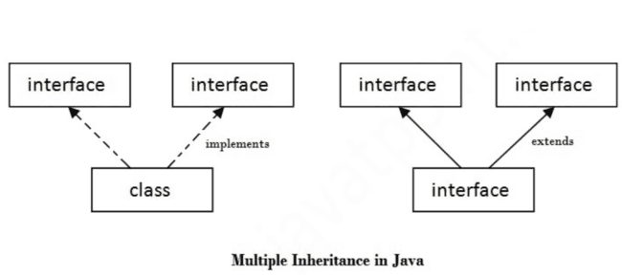
Multiple Inheritance in Java by Interface

Slide 148
interface Printable{
void ram (); } interface Showable{
void sita();
} class A7 implements Printable, Showable{ public void ram(){
System.out.println(”Hello”);}
public void sita(){
System.out.println(”Welcome”);}
public static void main(String args []){
A7 obj = new A7();
obj . ram (); o b j . sita ( ) ;
} }
Output:
Hello
Welcome

Slide 149
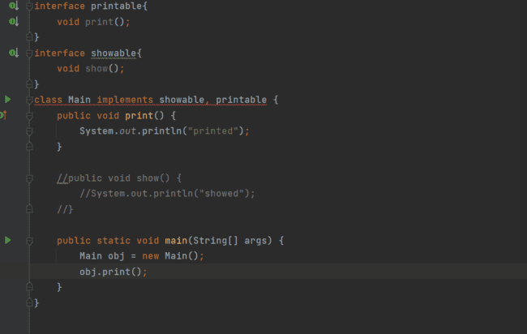


Slide 150
Interface can extends another interface
A class implements an interface, but one interface extends another interface.
interface Printable{ void print (); } interface Showable extends Printable{
void show();
} class TestInterface4 implements Showable{ public void print(){
System.out.println(”Hello”);}
public void show(){
System.out.println(”Welcome”);}
public static void main(String args []){
TestInterface4 obj = new TestInterface4 (); obj . print (); o b j . show ( ) ;
}
}
Output:
Hello
Welcome

Slide 151
Packages
Packages are used in Java in order to prevent naming conflicts, to control access, to make searching/locating and usage of classes, interfaces easier.
A Package can be defined as a grouping of related types (classes, interfaces) providing access protection and namespace management. Some of the existing packages in Java are
java.lang: bundles the fundamental classes java.io: classes for input , output functions are bundled in this package
Programmers can define their own packages to bundle group of classes/interfaces, etc.
It is a good practice to group related classes implemented by you so that a programmer can easily determine that the classes, interfaces are related.
Using packages, it is easier to provide access control and it is also easier to locate the related classes.

Slide 152
Creating a package (Ignore)
While creating a package, you should choose a name for the package and include a package statement along with that name at the top of every source file that contains the classes, interfaces, enumerations, and annotation types that you want to include in the package.
The package statement should be the first line in the source file.
There can be only one package statement in each source file, and it applies to all types in the file.
If a package statement is not used then the class, interfaces, enumerations, and annotation types will be placed in the current default package.

Slide 153
Creating package and Example for a Package
Then a folder with the given package name is created in the specified destination, and the compiled class files will be placed in that folder.
Let us look at an example that creates a package called animals. It is a good practice to use names of packages with lower case letters to avoid any conflicts with the names of classes and interfaces.
package animals ; interface Animal { public void eat ();
public void travel ();
}

Slide 154
Now, let us implement the above interface in the same package animals
package animals ;
public class MammalInt implements Animal {
public void eat () { System . out . println (”Mammal eats ”);
} public void travel () {
System.out.println(”Mammal travels”);
} public int noOfLegs () {
return 0;
}
public static void main(String args []) {
MammalInt m = new MammalInt ( ) ;
m. eat (); m. travel ();
} }

Slide 155
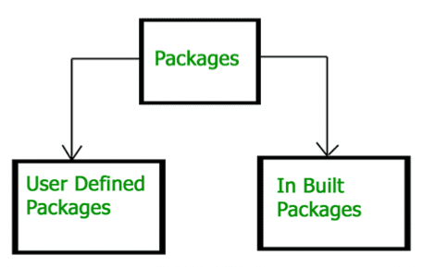
Types of Packages

Slide 156
Built-in Packages
These packages consist of a large number of classes which are a part of Java API. Some of the commonly used built-in packages are:
java.lang: Contains language support classes(e.g classed which defines primitive data types, math operations). This package is automatically imported.
java.io: Contains classes for supporting input / output operations.
java.util: Contains utility classes which implement data structures like
Linked List, Dictionary and support ; for Date / Time operations.
java.applet: Contains classes for creating Applets.
java.awt: Contain classes for implementing the components for graphical user interfaces (like button ,menus etc).
java.net: Contain classes for supporting networking operations.

Slide 157
User defined Packages
package myPackage ;
public class MyClass
{
public void getNames(String s)
{
System . out . p r i n t l n ( s ) ;
} }

Slide 158
importing MyClass from myPackage
Package myPackage
public class PrintName
{ {
public static void main(String args [])
// Initializing the String variable // with a value String name = ”Sudheer ”;
// Creating an instance of class MyClass in // the package . MyClass obj = new MyClass ();
obj .getNames(name); }}

Slide 159
Illustration of user-defined packages
Creating our first package: File name – ClassOne.java
package package_name ; public class ClassOne { public void methodClassOne () {
System.out.println(”Hello there its ClassOne”);
} }
Creating our second package: File name – ClassTwo.java
package package_one ; public class ClassTwo { public void methodClassTwo(){ System . out . println (” Hello there i am ClassTwo ”);
} }

Slide 160
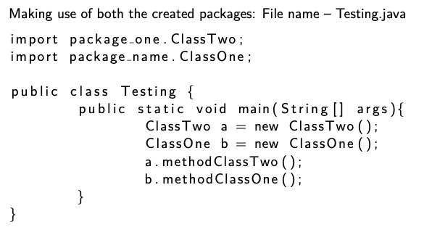

Slide 161
Object class in Java
The Object class is the parent class of all the classes in java by default. In other words, it is the topmost class of java.
The Object class is beneficial if you want to refer any object whose type you don’t know.
Let’s take an example, there is getObject() method that returns an object but it can be of any type like Employee,Student etc, we can use Object class reference to refer that object.
Object obj = getObject (); //we don’t know what object will be returned from this
The Object class provides some common behaviors to all the objects such as object can be compared, object can be cloned, object can be notified etc.

Slide 162
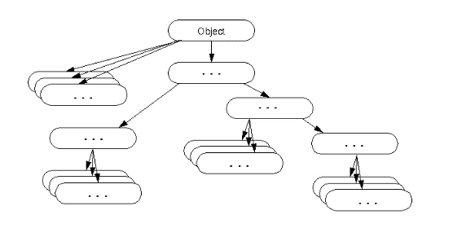

Slide 163
Object Cloning
The object cloning is a way to create exact copy of an object.
The clone() method of Object class is used to clone an object.
The java.lang.Cloneable interface must be implemented by the class whose object clone we want to create.
If we don’t implement Cloneable interface, clone() method generates CloneNotSupportedException.
The clone() method is defined in the Object class
protected Object clone () throws CloneNotSupportedExcep

Slide 164
Why use clone() method ?
The clone() method saves the extra processing task for creating the exact copy of an object.
If we perform it by using the new keyword, it will take a lot of processing time to be performed that is why we use object cloning.

Slide 165
Example for Object Cloning
class Student18 implements Cloneable{
int rollno ; String name; Student18( int rollno , String name){
this.rollno=rollno ;
this.name=name; } protected Object clone () throws CloneNotSupportedException
return super.clone ();} public static void main(String args[]) throws CloneNotSupportedException
Student18 s1=new Student18 (101 ,” amit ”); Student18 s2=(Student18)s1.clone();
System.out.println(s1.rollno+” ”+s1.name);
System.out.println(s2.rollno+” ”+s2.name); }}
Output:

Slide 166
Garbage Collection
In java, garbage means unreferenced objects.
Garbage Collection is process of reclaiming the runtime unused memory automatically. In other words, it is a way to destroy the unused objects.
To do so, we were using free() function in C language and delete() in C++. But, in java it is performed automatically. So, java provides better memory management.
Advantage of Garbage Collection
It makes java memory efficient because garbage collector removes the unreferenced objects from heap memory.
It is automatically done by the garbage collector(a part of JVM) so we don't need to make extra efforts.

Slide 167
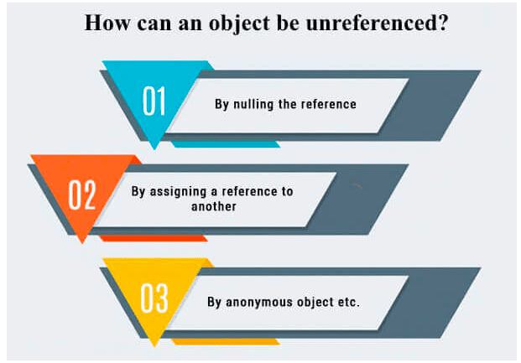
By nulling a reference:
Employee e = new Employee();
e= null;
By assigning a reference to another:
Employee e1=new Employee();
Employee e2=new Employee();
e1=e2;//now the first object referred by e1 is
available for garbage collection
By anonymous object:
new Employee();

Slide 168
finalize() method
The finalize() method is invoked each time before the object is garbage collected.
This method can be used to perform cleanup processing.
This method is defined in Object class as:
protected void finalize()
{ }
The Garbage collector of JVM collects only those objects that are created by new keyword. So if you have created any object without new, you can use finalize method to perform cleanup processing (destroying remaining objects).

Slide 169
gc() method
The gc() method is used to invoke the garbage collector to perform cleanup processing.
The gc() is found in System and Runtime classes.
public static void gc(){}
Garbage collection is performed by a daemon thread called Garbage Collector(GC). This thread calls the finalize() method before object is garbage collected.

Slide 170
Example for finalize() method
public class TestGarbage1{
public void finalize(){
System.out.println("object is garbage collected");}
public static void main(String args[]){
TestGarbage1 s1=new TestGarbage1();
TestGarbage1 s2=new TestGarbage1();
s1=null;
s2=null;
System.gc();
} }
Output:

Slide 171
Inner Classes
In Java, it is also possible to nest classes (a class within a class). The purpose of nested classes is to group classes that belong together, which makes your code more readable and maintainable. To access the inner class, create an object of the outer class, and then create an object of the inner class
class Outer {
int x = 10; class Inner {
int y=5;
}} public class Main { public static void main(String [] args) { Outer myOuter = new Outer (); Outer. Inner myIn = myOuter.new Inner ();
System.out.println(myIn.y * myOuter.x);
} }
Output:
50

Slide 172
private Inner classes
Unlike a regular class, an inner class can be private or protected. If you don’t want outside objects to access the inner class, declare the class as private:
class OuterClass {
int x = 10;
private class InnerClass {
int y=5;
}} public class Main { public static void main(String [] args) { OuterClass myOuter = new OuterClass (); OuterClass . InnerClass myIn = myOuter.new InnerClass ();
System.out.println(myIn.y + myOuter.x);
}}
Output:
Returns an error

Slide 173
Static Inner class
An inner class can also be static, which means that you can access it without creating an object of the outer class:
class OuterClass {
int x = 10;
static class InnerClass { int y = 5;
}} public class Main { public static void main(String [] args) { OuterClass . InnerClass myInner = new OuterClass . InnerClass();
System . out . p r i n t l n (myInner.y ) ;
}}
Output:
5

Slide 174
Access outer class from Inner Class
class OuterClass {
int x = 10;
class InnerClass {
public int myInnerMethod() {
return x;
} }} public class Main { public static void main(String [] args) { OuterClass myOuter = new OuterClass (); OuterClass . InnerClass myInner = myOuter.new InnerClass();
System . out . p r i n t l n ( myInner . myInnerMethod ( ) ) ;
}}
Output:
10

Slide 175
Examples for Inner Class
class Outer_Demo {
int num;
private class Inner_Demo {
public void print () {
System.out.println(”This is an inner class”);
}}
void display Inner () { Inner_Demo Inner = new Inner_Demo (); Inner . print ();
}}
public class My class { public static void main(String args []) {
Outer_Demo outer = new Outer_Demo ();
outer.display_Inner();
}}
Output:
This is an inner class

Slide 176
Accessing Private members from Inner class
public class My class2 { public static void main(String args []) {
// Instantiating the outer class
Outer Demo outer = new Outer Demo (); // Instantiating the inner class Outer Demo.Inner Demo inner = outer.new Inner Demo();
System . out . p r i n t l n ( i n n e r . getNum ( ) ) ;
}}
class Outer Demo { // private variable of the outer class
private int num = 175; // inner class
public class Inner Demo { public int getNum() { System.out.println(”This is the getnum method of th
return num;
} }}

Slide 177
Example for Method Local Inner class
public class Outerclass { // instance method of the outer class
void my Method() {
int num = 23; // method−local inner class
c l a s s MethodInner Demo { public void print () { System.out.println(”This is method inner class ”+num)
} } // end of inner class
// Accessing the inner class MethodInner Demo i n n e r = new MethodInner inner . print ();
} public static void main(String args []) {
Outerclass outer = new Outerclass (); outer.my Method();
} }
Demo ( ) ;

Slide 178
Programs for Practice
Write a java program that creates abstract class Calculation and contains add(), substract(), multiply(), and divide() methods. Make add() and multiply() as abstract methods in parent class which are defined in child class (AbstractionDemo) and call all these mehods via making object of child class.
Create interface namely A that has 4 methods a(),b(),c(),d(). Create abstract class named B that provides the implementation of one method of A interface say c(). Create subclass of abstract class named M, and provide the implementation of rest of the methods. Creating a test class that calls the methods of A interface.
Create an abstract class 'Parent' with a method 'message'. It has two subclasses each having a method with the same name 'message' that prints "This is first subclass" and "This is second subclass" respectively. Call the methods 'message' by creating an object for each subclass.

Slide 179
Implement Drawable interface that has only one method (void draw()). Its implementation is provided by Rectangle and Circle classes. In these class void draw implementation is provided that prints drawing rectangle and drawing circle statements, respectively. Call draw function appropriately.

